Slide 1
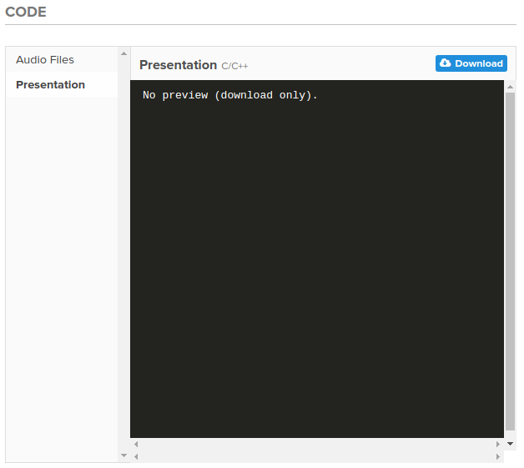
Pre-Workshop Setup
Plug in Beaglebone Black Wireless
Download Presentation
Go to below URL and download pdf/ppt file
https://goo.gl/p3Su87
Connect to Board
Power on Beaglebone Black Wireless
Plug in USB Cable to computer
Plug in USB cable to BBW
After ~4 minutes connect to board’s wifi access point
ssid is what you see on the board’s label
Passcode is beaglebone_<what you see on the label>

Slide 2



Super Intro Embedded Linux Workshop

Slide 3
Goals
Learn to use Beaglebone Black wireless
Play BopIt Game (using Computer Mouse)
Learn how to control peripherals via Python
Play BopIt Game (using Beaglebone Sensors)

Slide 4
Python
If your not family with Python
Ask a neighbor
Use a search engine
Quickly look at: http://www.nerdparadise.com/programming/python4minutes

Slide 5
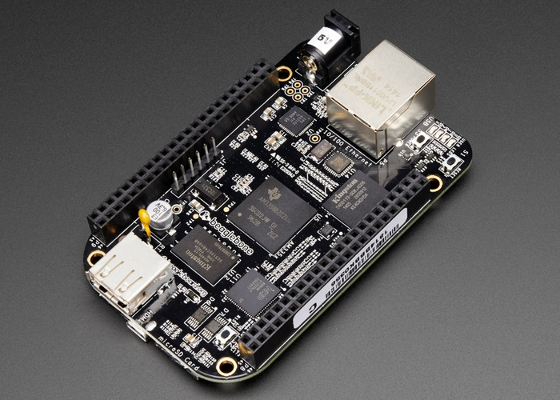
Beaglebone Black
Open Source Community Board
Uses Cortex A8 MPU
Runs at 1 GHz max
Supports ALOT of peripherals that are accessible

Slide 6
Lets Get Started

Slide 7
Pre-Workshop Setup
Plug in Beaglebone Black Wireless
Download Presentation
Go to below URL and download pdf/ppt file
https://goo.gl/p3Su87
Connect to Board
Power on Beaglebone Black Wireless
Plug in USB Cable to computer
Plug in USB cable to BBW
After ~4 minutes connect to board’s wifi access point
ssid is what you see on the board’s label
Passcode is beaglebone_<what you see on the label>

Slide 8
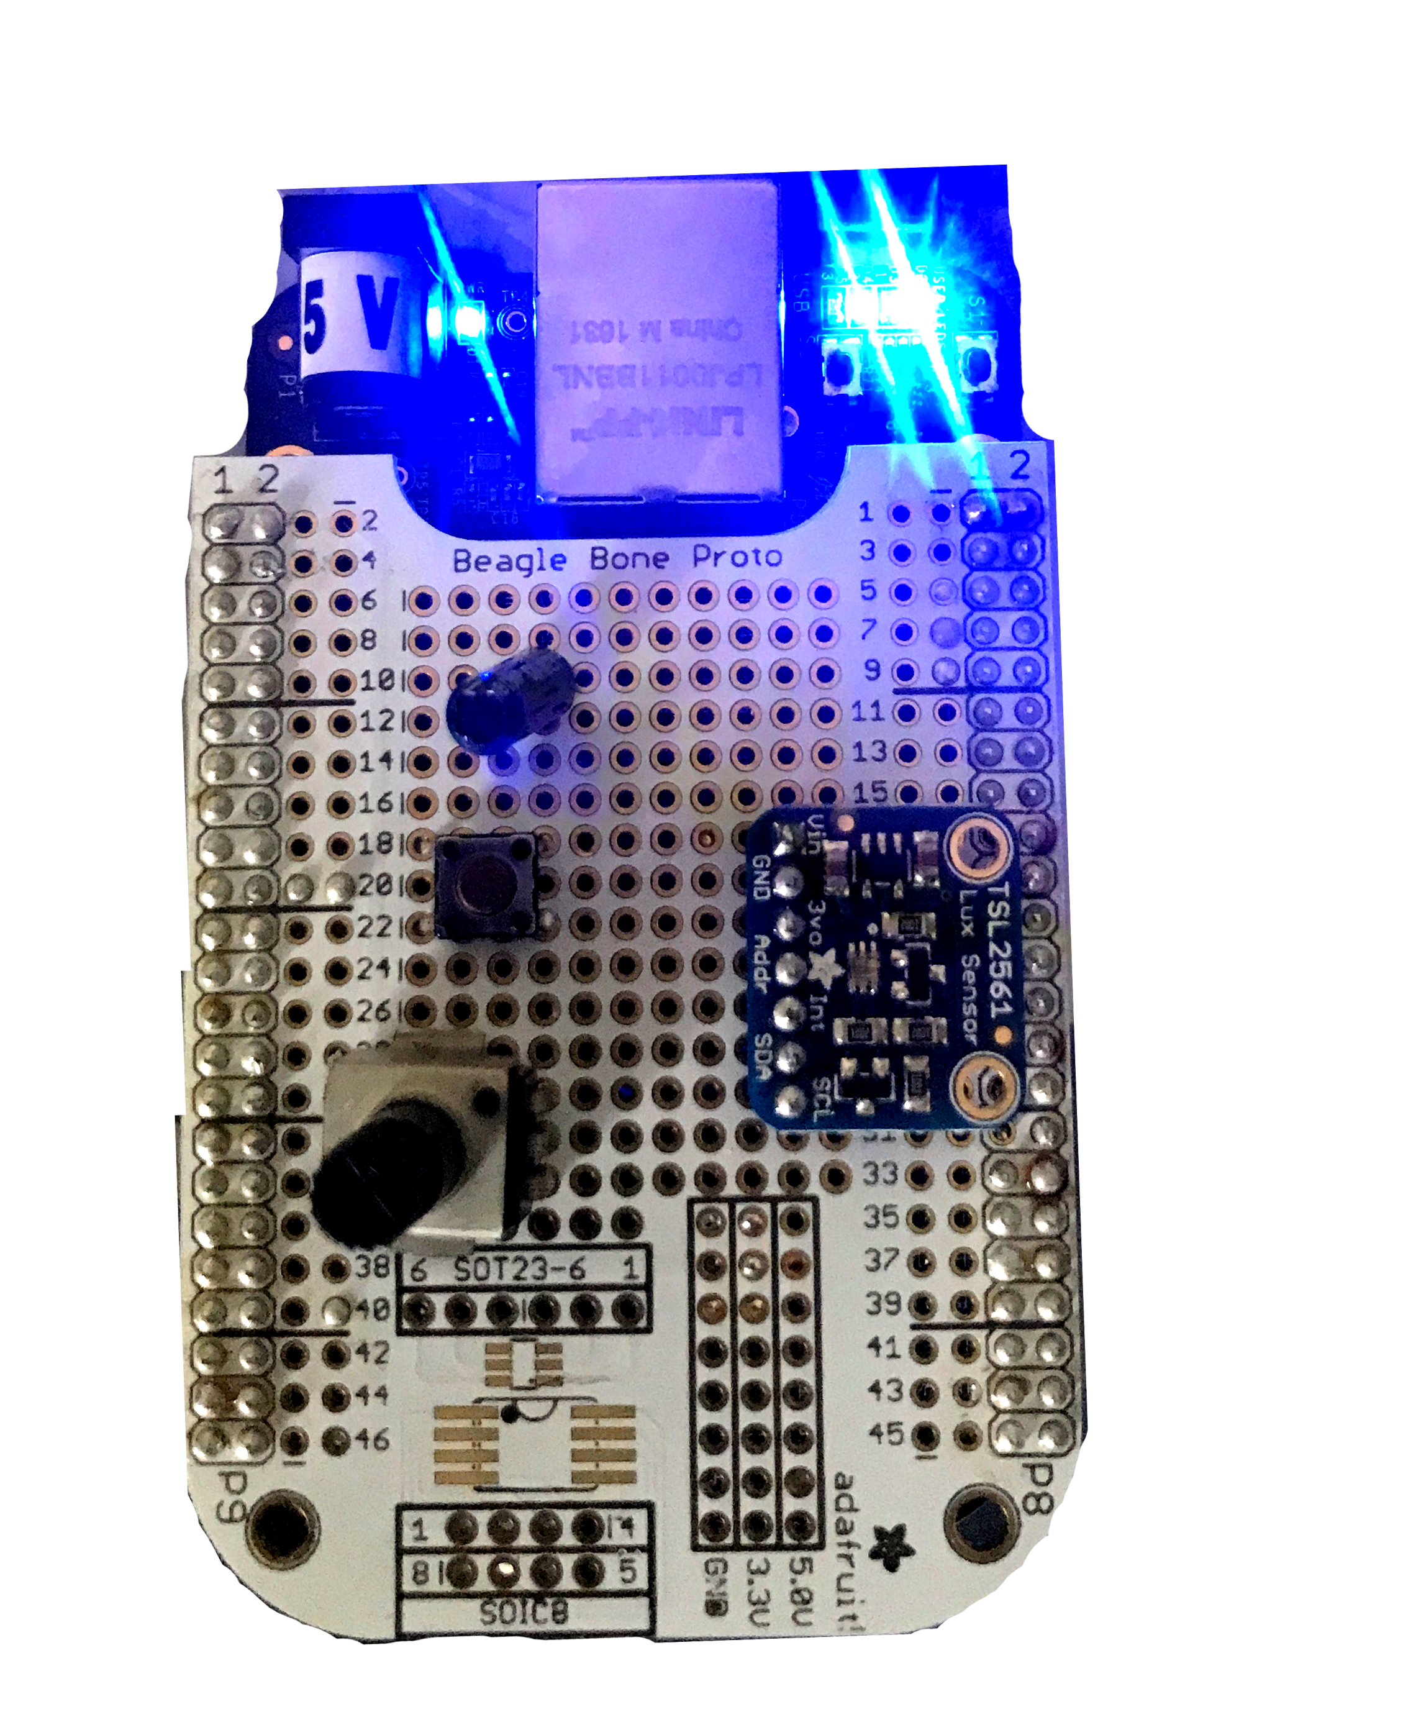
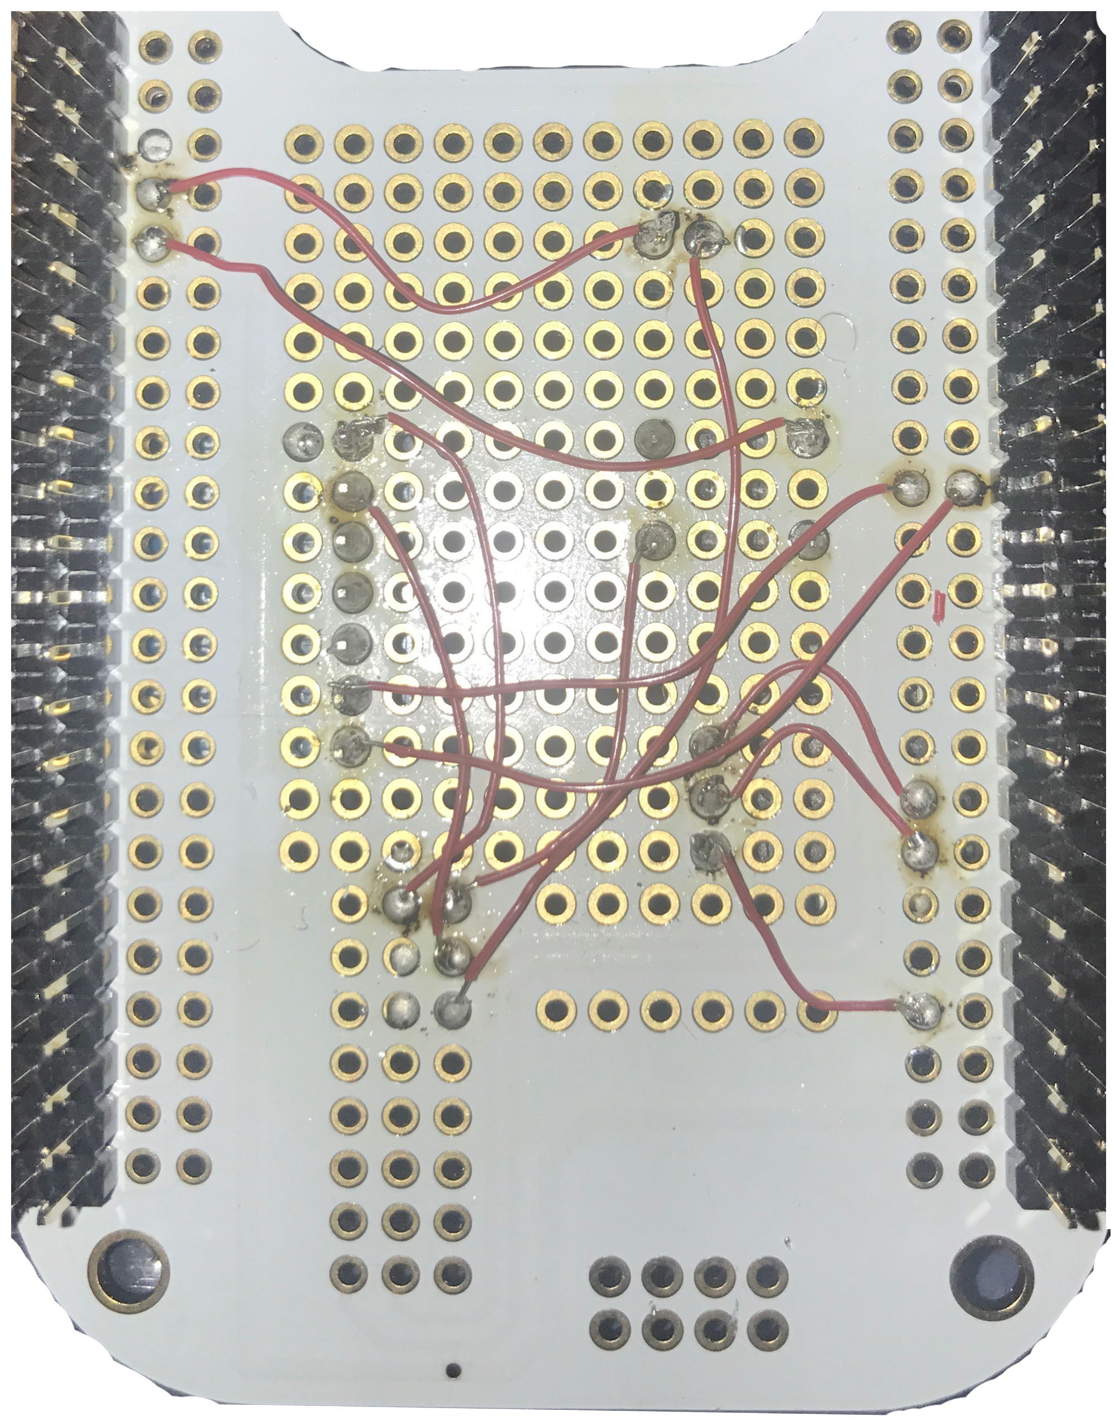
Beaglebone Workshop Cape

Slide 9
Cloud 9
Browser Base IDE (Supports Python and other languages)
When Beaglebone Black is connected to PC and booted Cloud 9 can be accessed by going to:
192.168.7.2:3000 (Windows)
192.168.6.2:3000 (Linux/Mac)

Slide 10
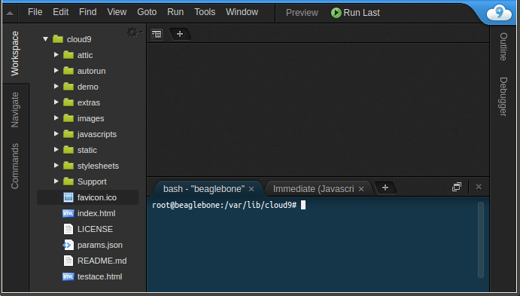
Cloud 9 Screen

Slide 11
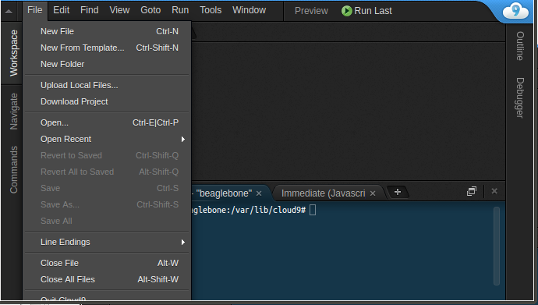
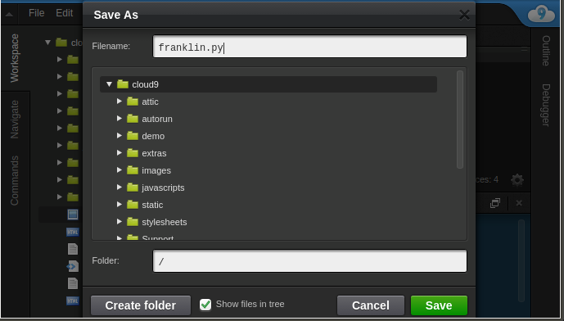
Create New File
Create New File
Goto File->New File
Now Save File
Goto File->Save
Give file a name but it MUST end with .py
Hit green Save button

Slide 12
Run Program
Always save File before running
Either File->Save or Ctrl and S (at the same time)
Two ways to run program (after saving)
Hit Green Run Button
Go to the “bash - “beaglebone” window
Type python “<your full filename>”
To halt execution hit Ctrl and C (and hold it)

Slide 13
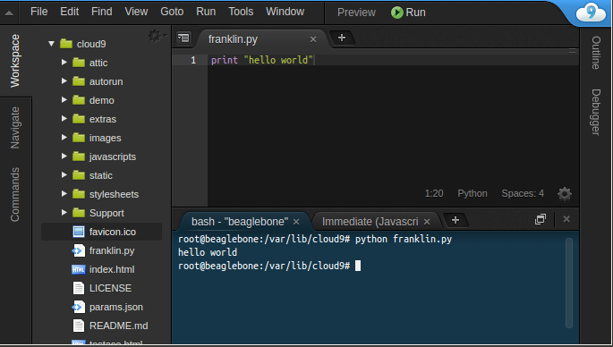
Running via Command Line

Slide 14
Final Cool Project

Slide 15
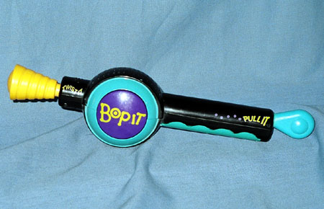
Beaglebone Based Bop It
Create a simplified version of the game Bop It

Slide 16
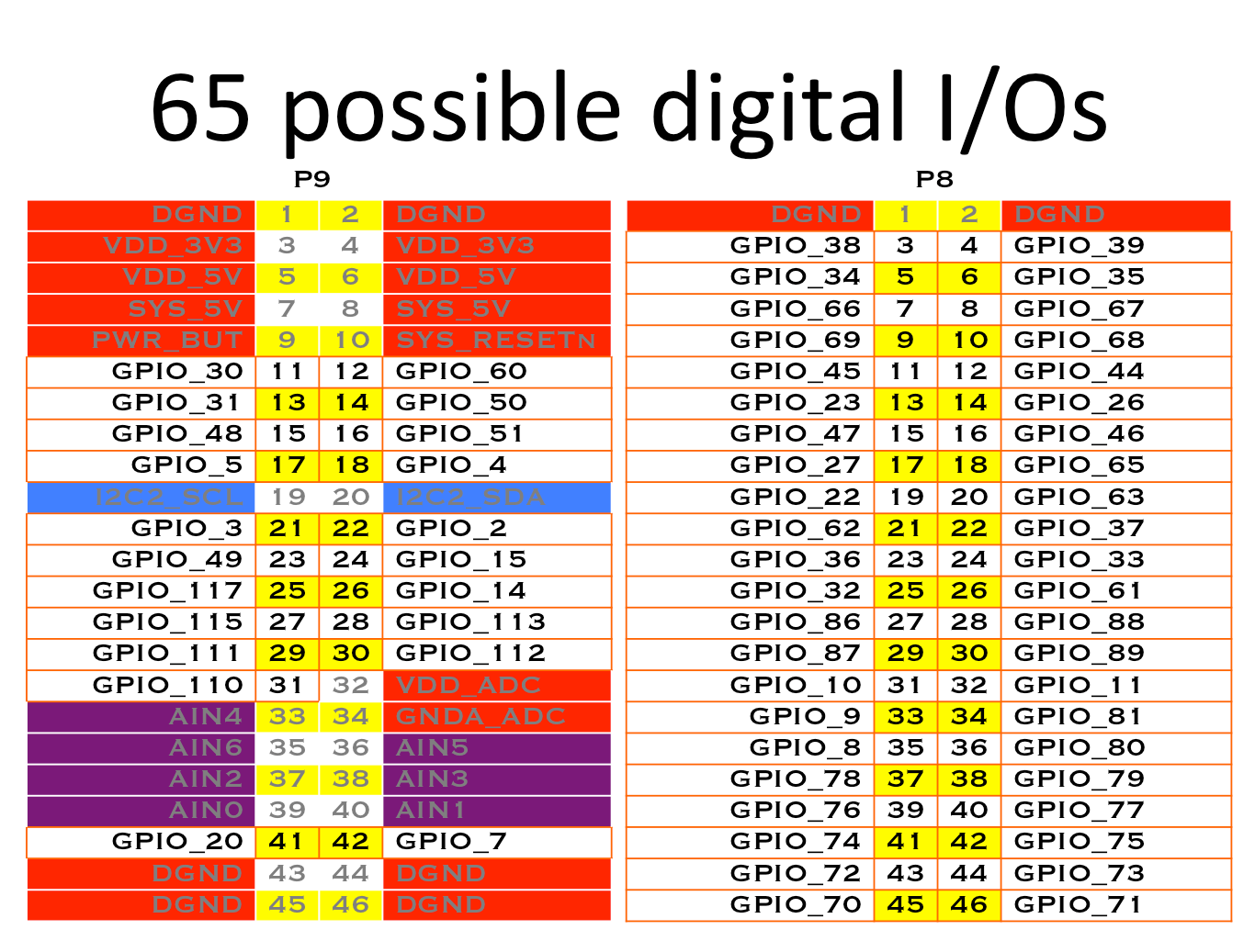
Peripheral - GPIO
Input -
High (1) : voltage >= 2 V
Low (0) : voltage <= .8 V
Output
High (1) : 3.3 V
Low (0) : 0 V

Slide 17
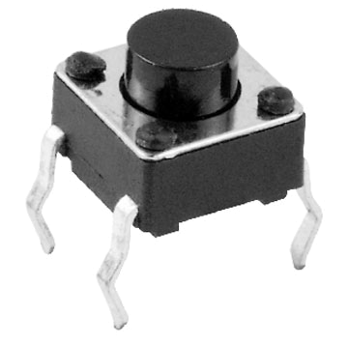
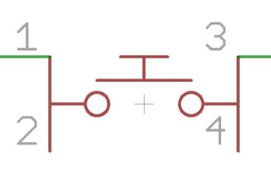
Component Push Button
Basic Switch – by default pins 1 and 2 are not connected to pins 3 and 4.

Slide 18
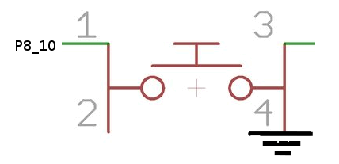
Schematic - Push Button
BBB Header Pin P8_10 is connected to one side of tactile switch. Ground is connected to other side of tactile switch.

Slide 19
Peripheral GPIO - Quiz
What is the value of a input pin when nothing is driving it (outputting a voltage to it)?

Slide 20
Peripheral GPIO - Quiz
What is the value of a input pin when nothing is driving it (outputting a voltage to it)?
NO ONE KNOWS

Slide 21
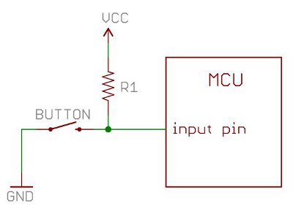
Hardware Concept - Pullup and Pulldown
Typical Usage:
Provide a steady/default value
BBB Pin Configuration:
Supports internal pullup and internal pulldown
Adafruit library by default configures GPIOs to be pull ups

Slide 22
Adafruit Library – 1 Sec Introduction
Adafruit created a peripheral library for BBB:
Python Based
Simple to Use
Lose some flexibility

Slide 23
Adafruit Library – GPIO Class
Including/Import
import Adafruit_BBIO.GPIO as GPIO
Configuration:
Input
GPIO.setup(“<PIN_NAME>”, GPIO.IN)
Output
GPIO.setup(“<PIN_NAME>”, GPIO.OUT)
Usage:
Input
GPIO.input(“<PIN_NAME>”)
Returns 1/True if voltage is high and returns 0/False if voltage is low
Output
GPIO.output(“<PIN_NAME>”, GPIO.HIGH) – Output High
GPIO.output(“<PIN_NAME>”, GPIO.LOW) – Output Low

Slide 24
Task 1 - GPIO
Create a Python program that outputs (via 'print' statement) some phrase when the push button goes low
Remember:
Try:
Tap push button once as fast as possible and see what your program outputs

Slide 25
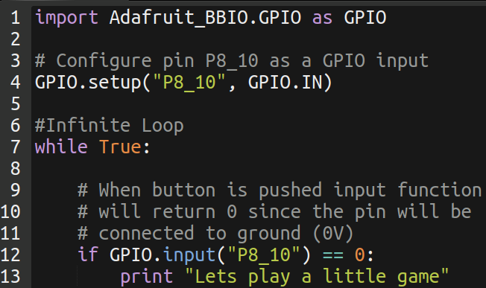
Task 1 - Solution

Slide 26
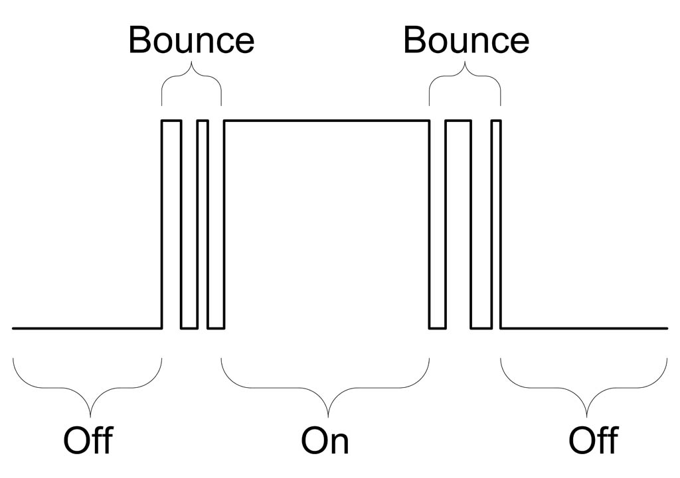
GPIO (Debounce)
Switch Bouncing:
Occurs when pushing or release buttons/switch

Slide 27
GPIO Debounce - Solutions
Simple software solution:
When state change ignore any future state changes for X ms
Can get complicated.
Adafruit has another approach that will be discussed later

Slide 28
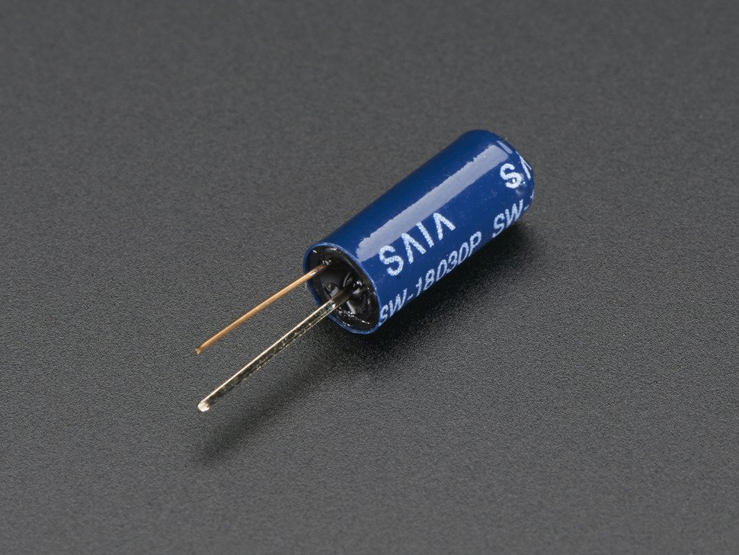
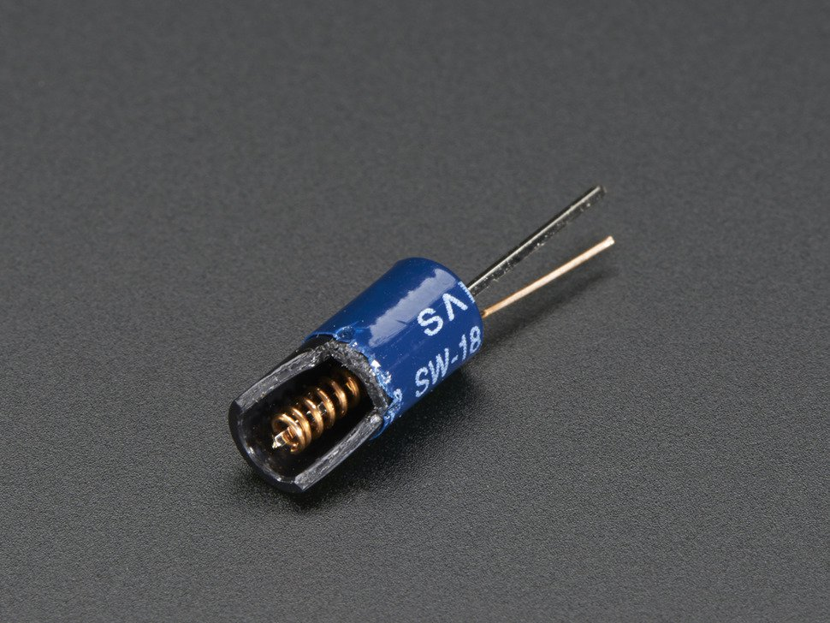
Component - Vibration Switch
Slow Vibration Sensor Switch
How does it work:
1 pin of the switch is connected to a metal pole. Other pin is connected to metal coil that goes around the metal pole.
Movement = temporary contact

Slide 29
Adafruit – GPIO Continued
GPIO.wait_for_edge(“<PIN_NAME>”, GPIO.RISING)
Blocking call
GPIO.add_event_detect(“<PIN_NAME>”, GPIO.FALLING)
Setup non blocking call
GPIO.event_detected(“<PIN_NAME>”)
Detect if state transition has occurred

Slide 30
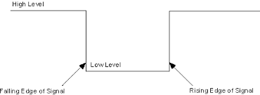
Peripheral – GPIO (Rising/Falling Edge)
Indicates a transition from a high level to low or vice a versa

Slide 31
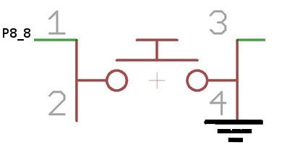
Task 2 – GPIO Event
Similar to previous assignment:
Output statement when vibration sensor is flicked (NOT TOO HARD)
Use GPIO event instead of raw input value
Important Hint:
Make sure in the code you use “P8_8” to refer to the pin. DO NOT use “P8_08”
Question:
To accomplish this assignment would you use falling or rising edge?

Slide 32
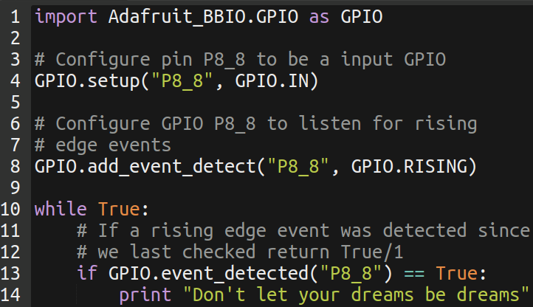
Task 2 - Solution

Slide 33

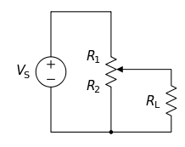
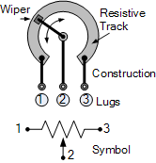
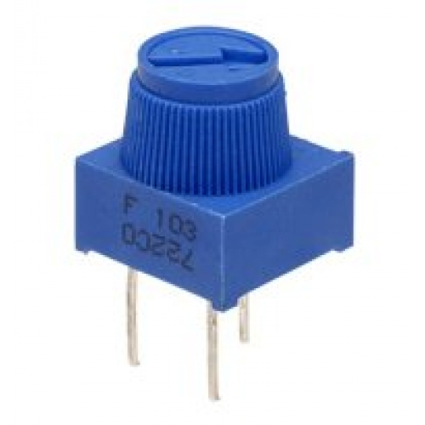
Component - Potentiometer
What is it:
Variable Resistor
Increase/decrease resistance via knob
Can be used as a voltage divider
Middle pin is output of divider

Slide 34
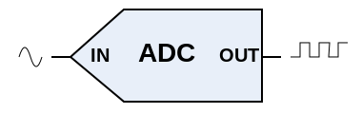
Peripheral - ADC
Purpose
Converts analog voltage to digital value
Useful for sensors that output voltage only
Beaglebone Black's ADC is a 12 bit ADC:
Digital Value Range
0 – 4095
Max support input voltage:
1.8 V

Slide 35
Adafruit - ADC
Import:
import Adafruit_BBIO.ADC as ADC
Configuration:
ADC.setup()
Reading:
Value from 0.0 to 1.0
value = ADC.read(“<PIN_NAME>”)
Raw Digital Value
value = ADC.read_raw(“<PIN_NAME>”)

Slide 36
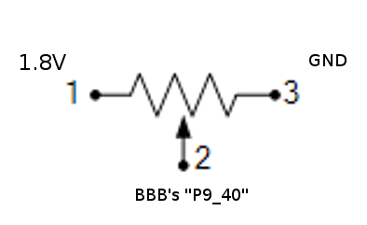
Task 3
Output message every time push button is pressed
How can I convert the ADC value read in by the Adafruit library and convert it to a voltage?

Slide 37
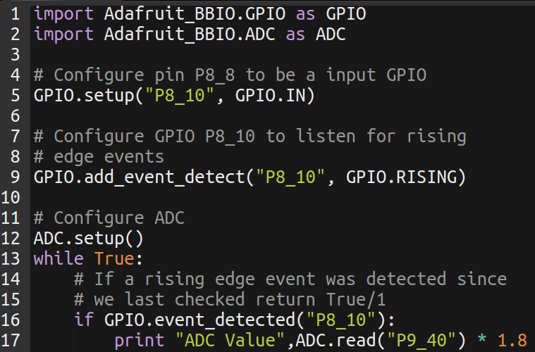
Task 3 - Solution

Slide 38
Peripheral - I2C
Quick Summary
Uses 2 Pins
SCL – Clock
SDA – Data
Half Duplex
Speed “Typical” Ranges 1K to 400K
Supports Multiple Nodes
Communicate to specific node via unique address
Multi Master

Slide 39
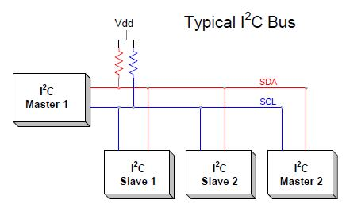
Peripheral – I2C (Bus)
Our Friend Pullups are back!

Slide 40
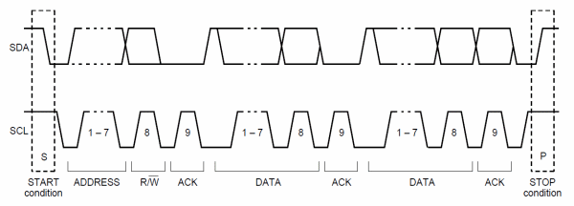
Peripheral – I2C (Reading/Writing)
Reading Procedure:
Send node address
Also set flag to read
Send address you want to read from
Read from node
Writing Procedure:
Send node address
Also set flag to write
Send address you want to write to
Write value(s) to node

Slide 41
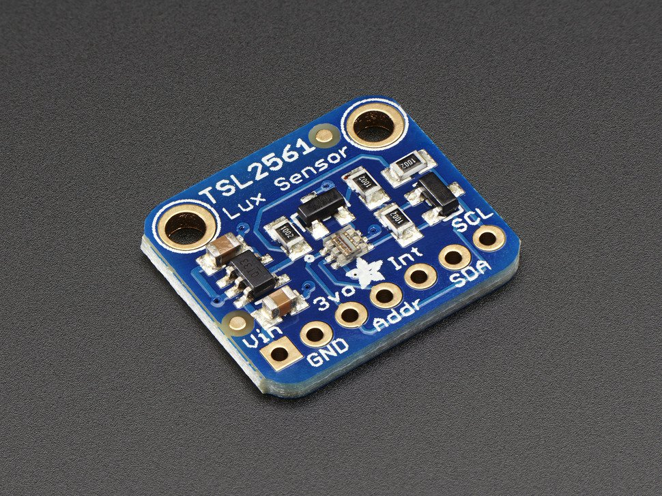
Component – Light Intensity Sensor
Summary:
Default address 0x39
Some boards have 49
marked on then if so use
0x49 instead
Requires Configuration
Has defined sample rate
Returns ambient light
levels

Slide 42
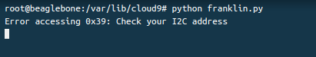
Task 4 – Read Light Sensor
Go To:
https://learn.adafruit.com/setting-up-io-python-library-on-beaglebone-black/i2c
Create program that does the following:
Configure I2C for slave address 0x39
Power On Device
Write value 0x3 to register 0x80 (128 in decimal)
Wait 14 ms
In an infinite while loop
Read and print unsigned 16 bits of data when pushed button is pressed
From register 0xAC (172 decimal)
Use slave address 0x49 if you see
the following ->
Question:
How does the output change when you block light from it?

Slide 43
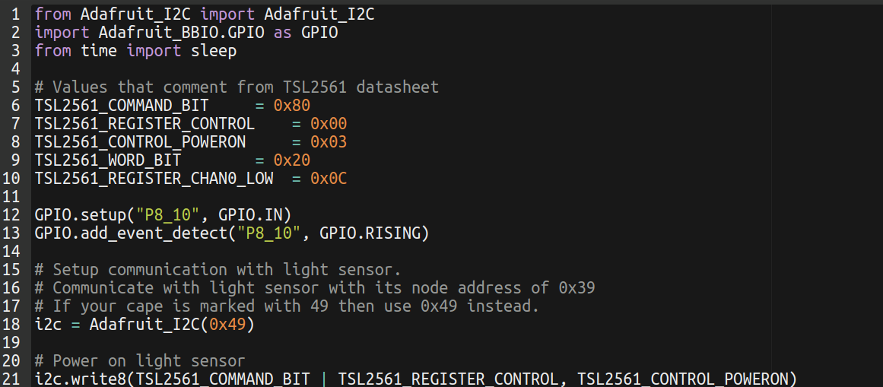
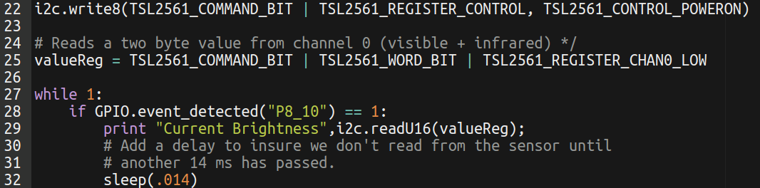
Task 4 - Solutions

Slide 44
Link to Project
https://www.hackster.io/fcooper27/intro-embedded-linux-06c3b8

Slide 45
Final Task – Bop It
Create a simplified version of the game Bop It

Slide 46
Bop It – How It Works
Its a game similar to Simon Says
The game continuously randomly ask the user to perform an action
Make sure “only” the correct action is performed in X amount of seconds
Otherwise user loses
Our actions are:
Turn it – Turn Potentiometer
Block It – cover light sensor
Flick it – Flick vibration sensor (NOT TOO HARD)
Push It – Push tactile button

Slide 47
Bop It – High Level
Program Starts
Wait 4 seconds and play intro audio
Wait until has pushed and released button (rising edge) the button
Randomly output an action to perform
Play audio for “correct action”
Check all actions to see if they are being performed
Avoid blocking calls.

Slide 48
Bop It – Python Useful New Functions
Useful new Python Functions:
Sleeping – Block Execution for X amount of seconds. Supports fractional sleep (ms sleep)
from time import sleep
sleep(.1) # 100 ms
random.randint(startNum, endNum) – Return random interger between and including startNum and endNum
Find difference in time (ms)
Call and store
int(round(time.time() * 1000))
At a later point call and store
int(round(time.time() * 1000))
Take the difference and thats the time difference in ms

Slide 49
Bop It – PyGame Library
PyGame useful library for making Python games.
https://www.pygame.org/docs/ref/music.html
We will just use audio library
Import:
from pygame import mixer
Configuration
mixer.init()
Load Audio File
sound = mixer.Sound(“<path and name of audio file to load>”)
Play Audio File
sound.play()
sound.play(loops=-1)
Stop Playing Audio
sound.stop()
Check if Audio is playing
sound.get_busy()

Slide 50
Bop It – Useful Peripheral Tips
For Turning Detection Function:
Read ADC, store the time and value read
Future calls if it was within X amount of sec/ms of the above
Return false - if the difference between stored and current ADC value is below some threshold
Return true - if the difference between stored and current ADC value is above some threshold

Slide 51
Bop It – Useful Peripheral Tips Cont
For Flicking Detection Function:
Debouncing is very much an issue. So use GPIO event detect.
For Blocking Detection Function
If light intensity is below a threshold (pick a value via testing) then return true that its currently being blocked otherwise return false
Remember between each read light intensity calls you need to wait atleast 14 ms.

